Slide 1


Slide 2
Introduction to Function
Calls In MIPS Assembly
Beyond the LMC

Slide 3
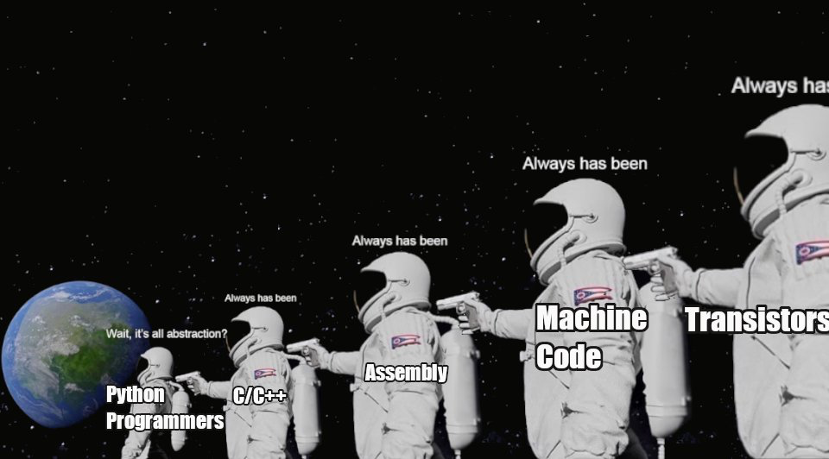
Course Syllabus

Slide 4
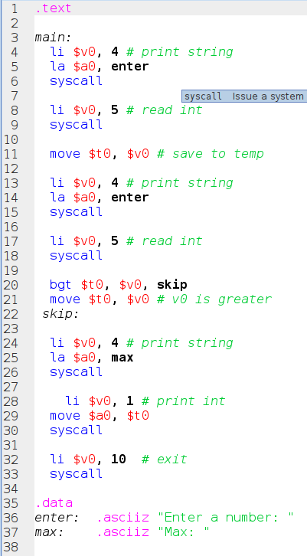
MIPS
In the last lecture we looked at an introduction to MIPS
It was a little annoying that we had had to keep writing all that code out to just print a string, wasn’t it?
Notes:
Can be found online… but I can’t link to it

Slide 5
MIPS
If we were programming in a high level language like C, we would write a function for this (assuming it wasn’t built in)
Something like: void print_str(char* str)
Notes:
Can be found online… but I can’t link to it

Slide 6
MIPS
How can we achieve the same thing in assembly?
Well, let’s take that first print string and rearrange it so that we jump to some logic to print the string
To do this, we are going to need to define a calling convention
Notes:
Can be found online… but I can’t link to it

Slide 7
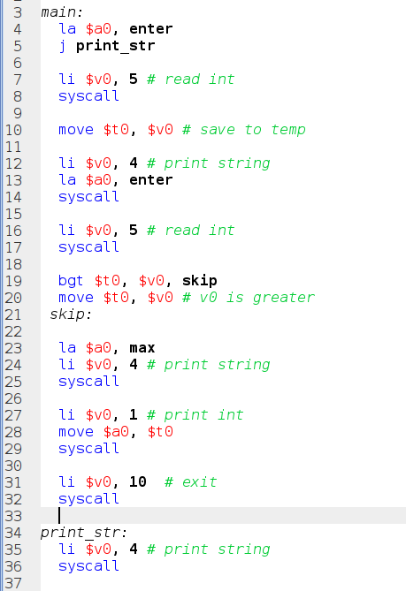
Subroutines
A calling convention is a set of rules we use to coordinate “both sides” of a function call:
The caller - the code calling the function
The callee - the code being called
Remember, at the hardware level, there are no “functions”
Notes:
Can be found online… but I can’t link to it

Slide 8
Subroutines
Functions are a conceptual entity that we impose on top of the hardware by using conventions
Let’s start off with a very simple convention:
The $a1 register holds the first argument to a function, in this case the address of the string to print
Notes:
Can be found online… but I can’t link to it

Slide 9
Subroutines
OK, so we put the address of the string we want to print in $a0 with the `la` instruction (load address)
Next we need to jump to the address of the functions implementation
Notes:
Can be found online… but I can’t link to it

Slide 10
Subroutines
We’ll label the area we pull the logic out to print_str so we can jump to it
This label is the functions name
Looks reasonable!
What happens if we run this code?
Notes:
Can be found online… but I can’t link to it

Slide 11
Subroutines
Hmm, OK
We just ran off the end of the program and exited
We need some way to jump back to where the syscall was made...
Notes:
Can be found online… but I can’t link to it

Slide 12
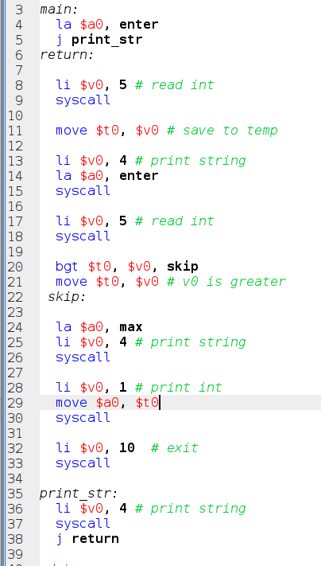
Subroutines
OK, let’s add a return label and jump back there after the sub-routine has completed
Hey, it works!
But can we reuse this sub-routine elsewhere?
No, unfortunately the return address is hard-coded in the function body
Notes:
Can be found online… but I can’t link to it

Slide 13
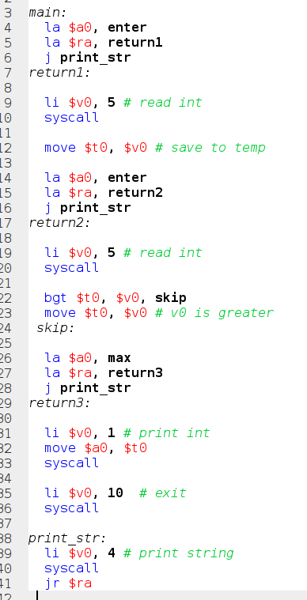
Subroutines
OK, so let’s make that dynamic: we’ll use a register to store the address that we want to jump back to
Turns out there is a register for this, $ra, the return address register
Notes:
Can be found online… but I can’t link to it

Slide 14
Subroutines
This becomes another part of our calling convention: before we call a function we need to push the return address into the $ra register
Now, rather than using a jump instruction, we can use the jr, or jump register instruction to jump to the address in the $ra
Notes:
Can be found online… but I can’t link to it

Slide 15
Subroutines
OK, now we are getting somewhere: we can reuse this subroutine everywhere in our program by placing a label… where?
We place the return label on the instruction after the call instruction
Notes:
Can be found online… but I can’t link to it

Slide 16
Subroutines
Well, OK, we are reusing the print_str function
But is this any better than what we had before?
It’s actually a bit longer…
That’s too bad
Notes:
Can be found online… but I can’t link to it

Slide 17
Subroutines
Again, note the pattern here:
Jump to some other location and then return to the next instruction
This is such a common pattern that modern processors have a special instruction for it
On MIPS this is the jump and link (jal) instruction
Notes:
Can be found online… but I can’t link to it

Slide 18
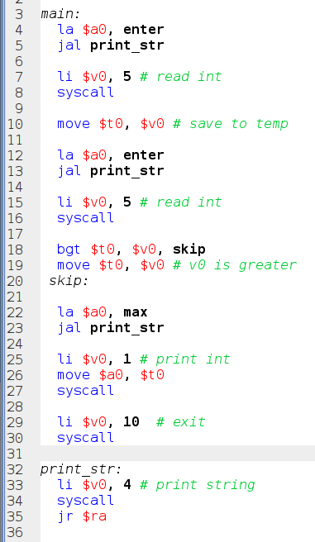
Subroutines
The jump and link instruction will push the next instructions address into the $ra register and then jump
Program counter + 1
Now we are cooking with gas!
Note also we are making use of another special function-related instruction: jr or jump return
Notes:
Can be found online… but I can’t link to it

Slide 19
Subroutines
Jumping to the address stored in $ra is so common that it gets its own pseudoinstruction
OK, so using all these tools, we are able to define and invoke a function in our assembly!
Doesn’t look like a C-function, but this is how it started!
Notes:
Can be found online… but I can’t link to it

Slide 20
Subroutines
Note that, technically, I am calling this a subroutine
Definitions vary, but when I use the term subroutine I mean “code that does not return a value, called only for its side effects”
Notes:
Can be found online… but I can’t link to it

Slide 21
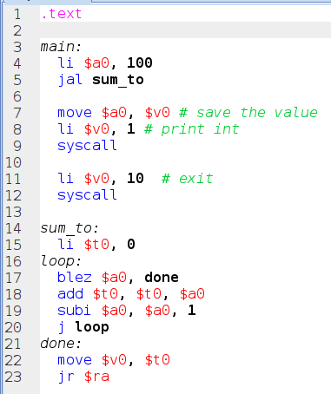
Functions
OK, but what about a more sophisticated function that does more than just call to the OS to print a string?
What if we wanted to, for example, actually return a value from a function?
Notes:
Can be found online… but I can’t link to it

Slide 22
Functions
Let’s take a look at a sum_to function that would look something like this in C: int sum_to(int x) { int temp = 0; while(x > 0) { temp += x--; } return temp }
Notes:
Can be found online… but I can’t link to it

Slide 23
Functions
Since we are returning a value from this function we are going to need to extend our calling convention:
Let’s use the $v0 register to hold the return value
$a0....$a3 - arguments
$v0, $v1 - return values
$ra - return address
Notes:
Can be found online… but I can’t link to it

Slide 24
Functions
Note that there is nothing special about the label sum_to
There is a “function” at this memory location simply because we follow the calling convention we have defined
Functions aren’t real!
Notes:
Can be found online… but I can’t link to it

Slide 25
Functions
Let’s look at the function implementation
We use a temporary variable to keep track of the sum
We use the blez instruction in the while loop: Branch if less than or equal to zero
Note that we have to move $v0 to $a0 before the system call to avoid stomping on it
Notes:
Can be found online… but I can’t link to it

Slide 26
Functions
Let’s run this code and see what happens
Sure enough, it works!
This is the assembly version of that while loop based C function we saw earlier
All stitched together using the calling conventions we defined
Notes:
Can be found online… but I can’t link to it

Slide 27
MIPS
Function calls are based on calling conventions
These calling conventions coordinate the caller and the callee
On MIPS:
$a0-a3 are used to pass arguments
$v0-v1 are used to store return values
$ra is used to store the return address to jump back to
Special instructions exist to assist in implementing function calls:
jal - Jump & Link: jumps to the given address and saves the next instruction address into $ra
ret - Jumps back to the address stored in $ra

